Slide 1

DEPARTMENT OF CSE, NORTH SOUTH UNIVERSITY
CSE445
Plant Disease Classification
SOLEMAN HOSSAIN 2021682042
NAFIS MAHMUD 2022396042
SHAHRIAR RATUL 2111514642
DURJOY BARUA 2131766642

Slide 2
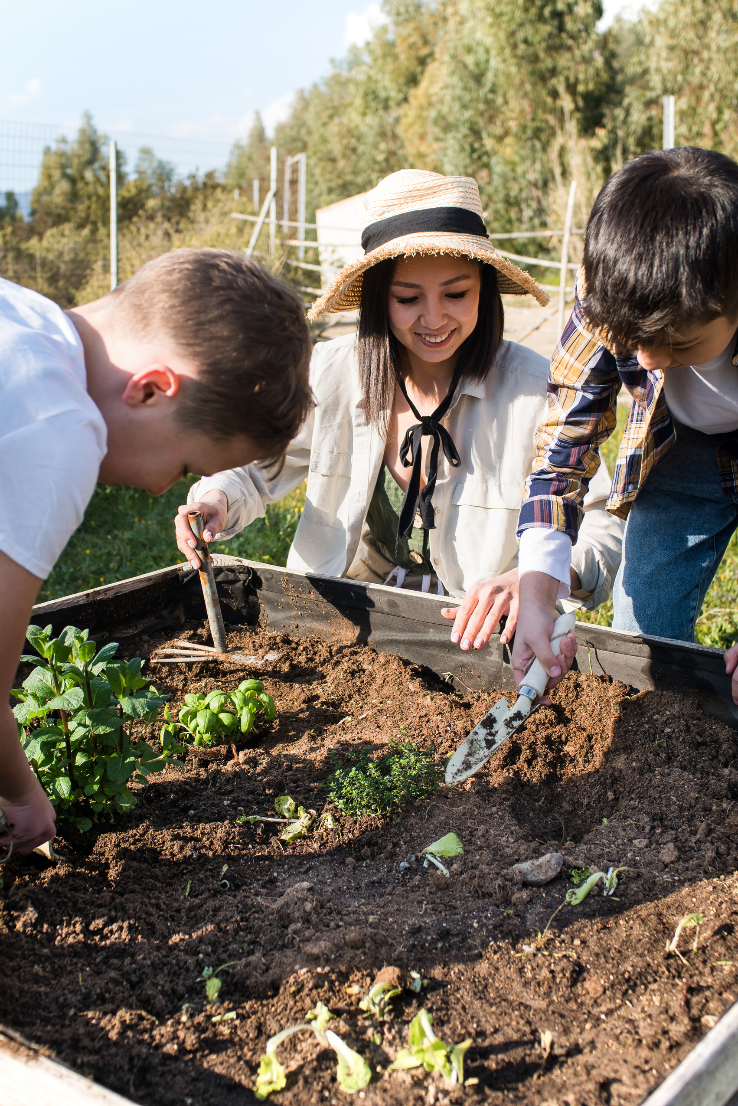



Introduction
Problem
Vision
Plant diseases reduce crop yield and quality.
Early detection is essential to reduce losses.
To revolutionize agriculture through AI-powered early detection of plant diseases, enhancing food security and sustainability worldwide.

Slide 3
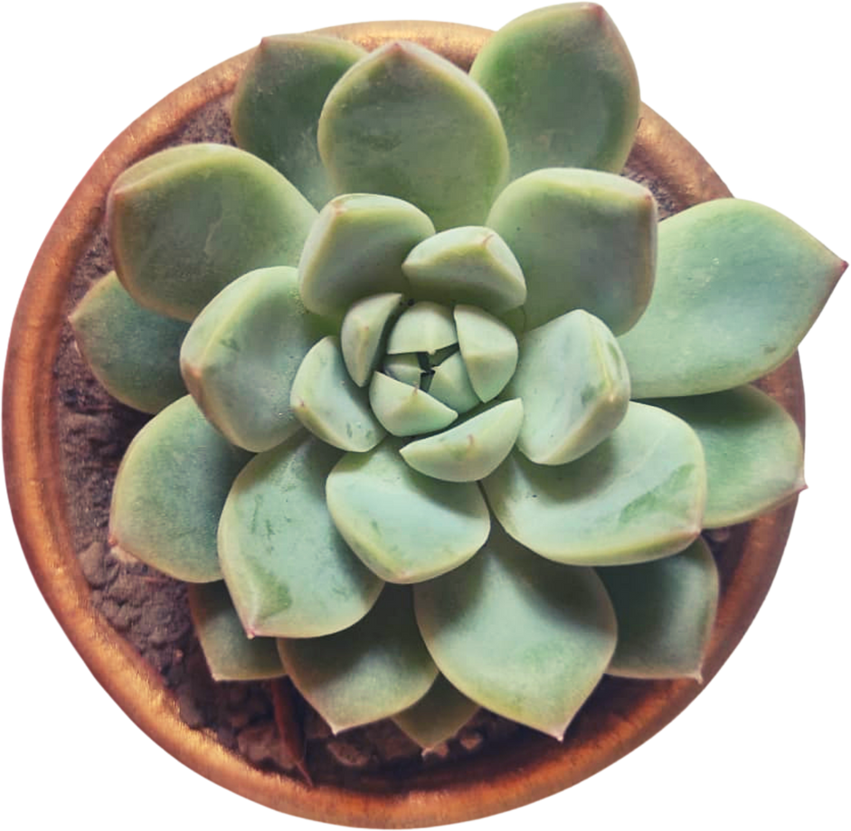
DATASET
Source: Kaggle Plant Disease Dataset
Total Classes: 38 (Healthy + Diseased)
Splits: Train / Validation / Test
Image Size: 128 × 128

Slide 4


Methodology
Python 3.12.6, CUDA Toolkit 12.6, PyTorch
Preprocessing using torchvision.transforms
Feature extraction: CNN
Classification: MLP
Metrics: Accuracy, Precision, Recall, F1-score

Slide 5
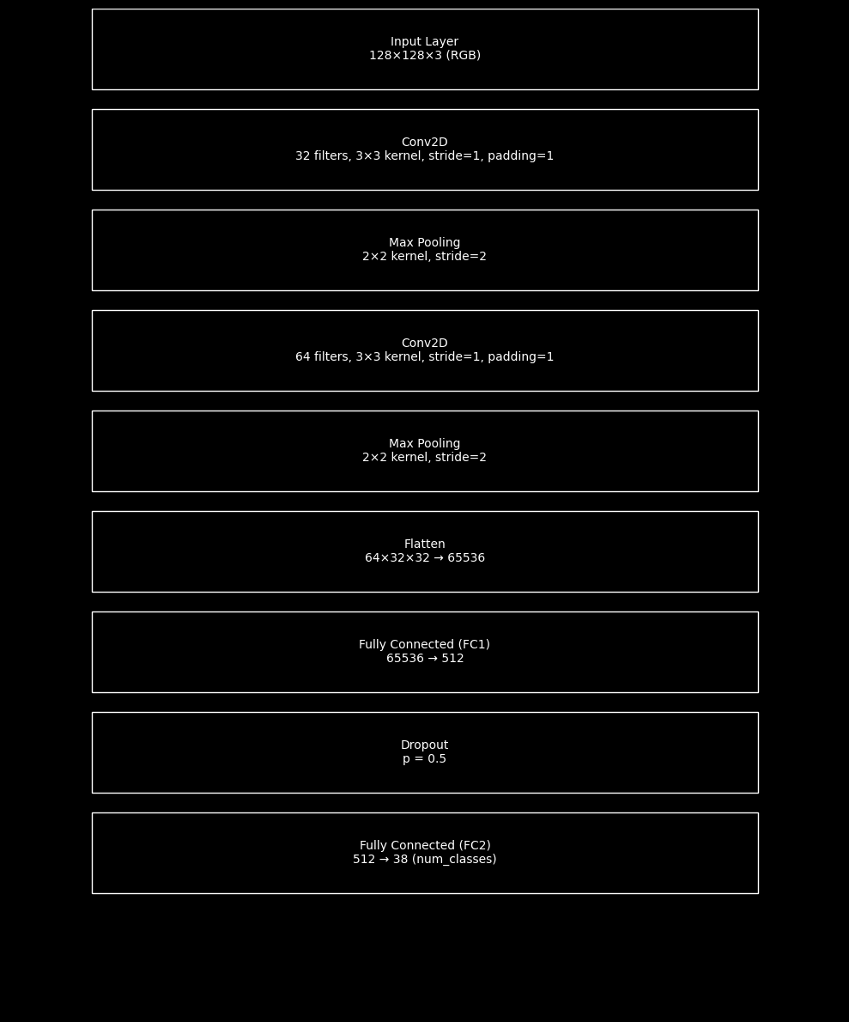

Model Architecture
CNN Feature Extractor:
2 Conv2D Layers
MaxPooling
Classifier (MLP):
Fully Connected Layer
Dropout
Optimizer: Adam (lr=0.001)
Scheduler:
StepLR (decay every 7 epochs)

Slide 6




IMPLEMENTATION
Implemented in Jupyter Notebook
Used DataLoader for batching
tqdm for progress bar
Trained for 3 epochs with batch size 16

Slide 7
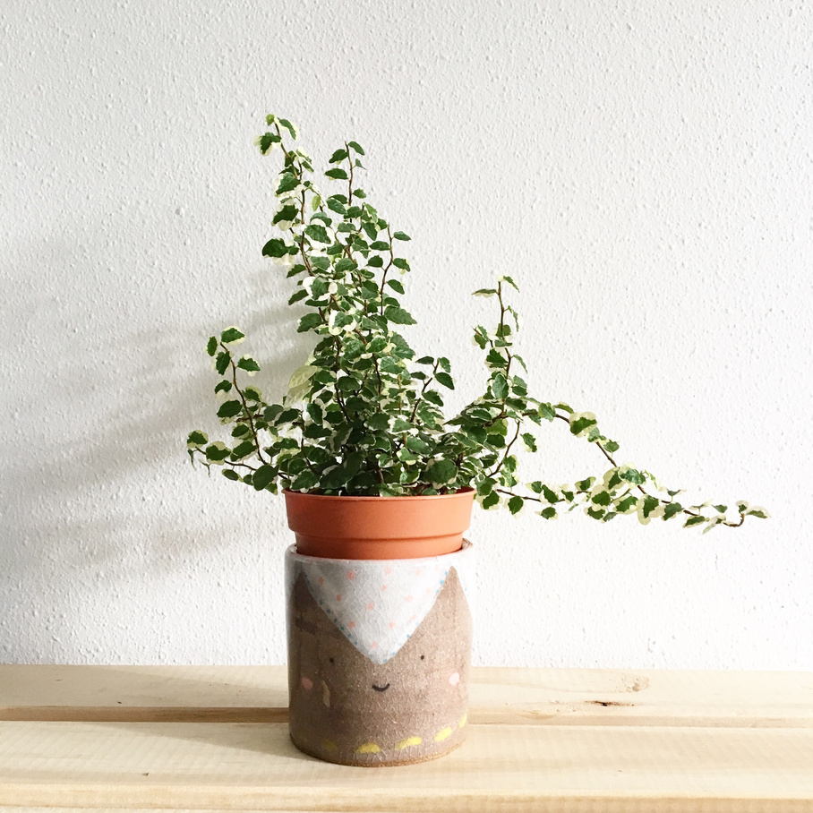
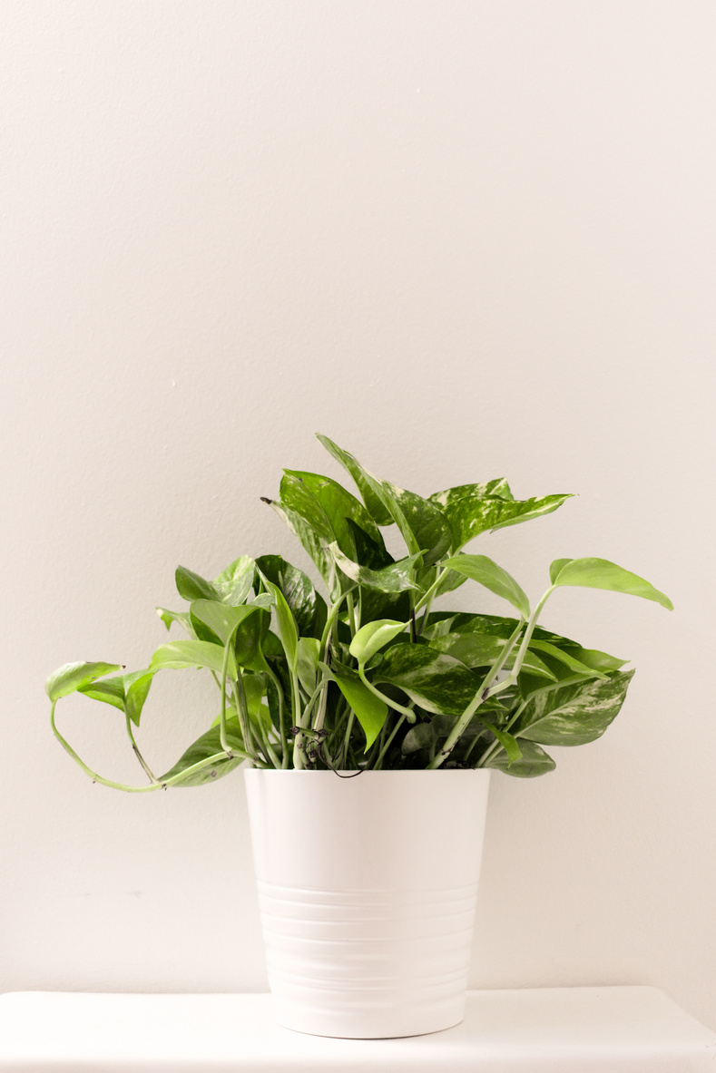


Evaluation of Our Model
ACCURACY: 92%
PRECISION: 92%
F1-SCORE: 92%
RECALL: 92%
PRODUCT 02
PRODUCT 03

Slide 8




HOME
SERVICE
ABOUT US
CONTACT US
Evaluation Insights
Strong performance overall
Some misclassifications in similar classes
PR Curve shows:
High AP for most classes
Lower AP for some (e.g., Grape Black Rot = 0.44)
ROC AUC mostly ~0.98–1.00

Slide 9
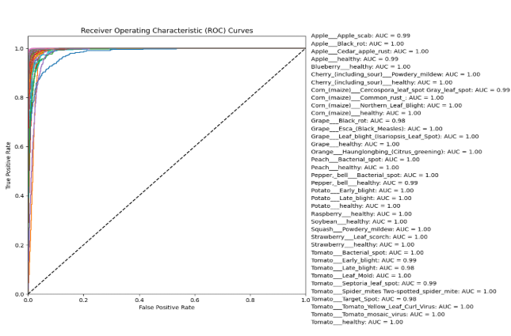

ROC CURVE

Slide 10
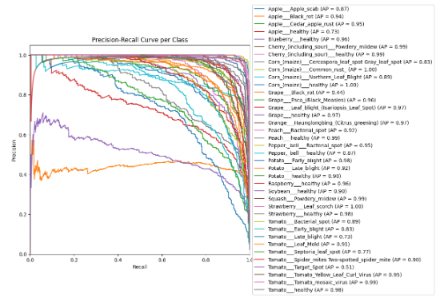
PRECISION-RECALL CURVE

Slide 11
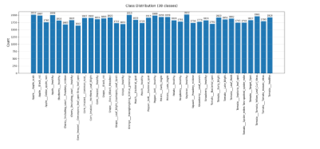
CLASS DISTRIBUTION
BALANCED DATASET ACROSS 38 CLASSES
EACH CLASS: 1700–2022 IMAGES
PROMOTES FAIRNESS AND REDUCES MODEL BIAS

Slide 12
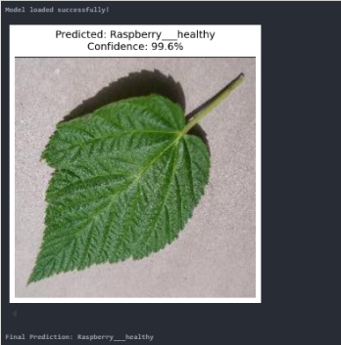
SAMPLE OUTPUT
Image classified as Raspberry healthy
Accuracy: 99.6% confidence
Model: SimpleCNN + MLP
Used predict_image() with preprocessing and softmax

Slide 13
Overview
GPU-accelerated MLP model is fast and accurate
Competitive performance vs CNNs
Suitable for real-world agricultural deployment
Future work:
Hybrid models
More robust optimization

Slide 14

Thank You

